Slide 1

COMPUTER SOFTWARE

Slide 2
Content
Introduction
Terminologies
Classification of software
System software
      Types of system software
      Functions of operating system
Application software
      Types of application software
      Uses of application software

Slide 3
Introduction
Computer software (software) is the set of digital instructions that control the actions of a computer.
It is a series of instructions that tell the hardware how to work.
The process of making software is called programming/coding, and is done by programmers.

Slide 4
Terminologies related to software
Software Installation:
This is the process of setting up of a program on a computer to be able to use it.
2) A software suit:
This is a collection of individual application soft-ware programs sold as a single package.
3) Log on:
This is the process of entering a user name and a password into the computer.

Slide 5
Terminologies related to software…
4) Password.
This is a combination of characters associated with the user name that allow a user to access a computer, a file or a network.
5) Cryptography:
This is the art of hiding information by transforming it (encrypting it) into an unreadable format, called cipher text such that Only those who possess a secret key can interpret (decrypt) the message into plain text.

Slide 6
Terminologies related to software…
8) A user interface:
This refers to the part of the software with which you interact; it controls how data and instructions are entered and information is presented on the screen.
Software upgrade: This is the purchase of a newer version of software you currently use.
10) Software update:
This is software that provides bug fixes for features that are not working quite right and minor software enhancement.

Slide 7
Terminologies related to software…
9) 11) Trouble shooting: This is the process of diagnosing the source of the problem.
12) A bug: this is an error in a program
13) Debugging: this is the process of removing errors in a program to make it work as expected
14) Compilation:
This is the process of transforming a program in a high level language into a machine code

Slide 8
Characteristics of computer software
Copy righted
It can be installed on computers
Has a source code written by a programmer
It is intangible
It gives instructions to the computer.

Slide 9
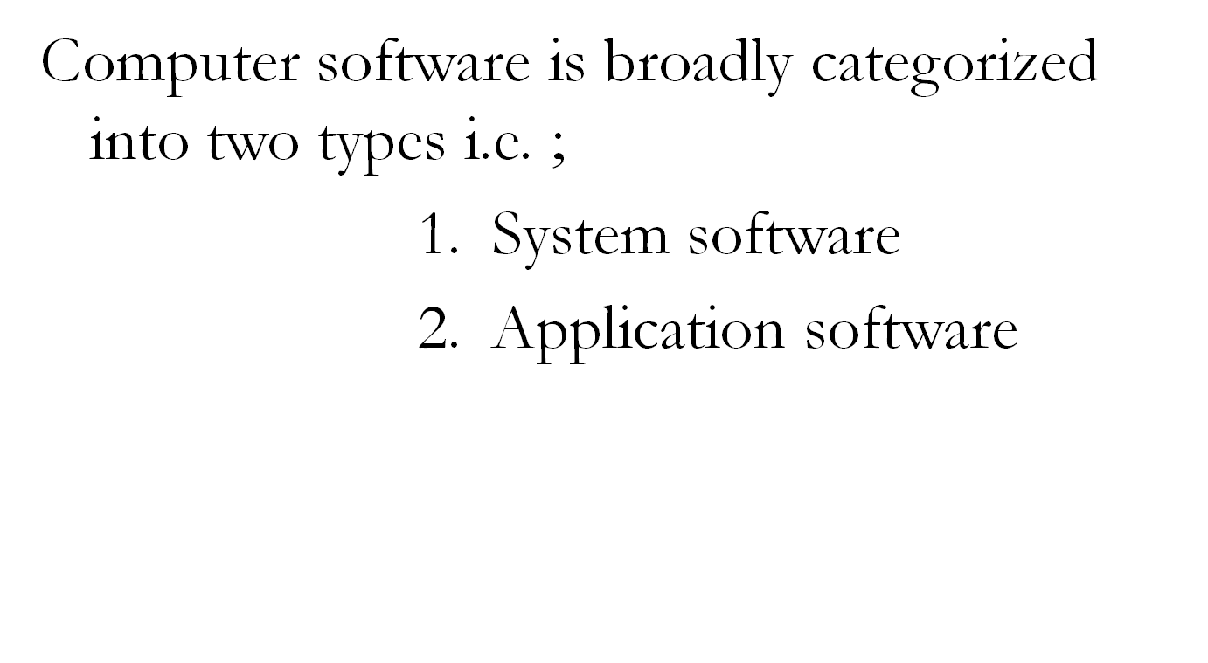
Classification of Software

Slide 10
Illustration showing software Classification
SOFTWARE
System software
Application software
Operating system
Utility programs
Programming languages
Customized / user made S/W16
Off the shelf S/W
Stand alone O/S S/W
Low level
Networked O/S
High level
Embedded O/S

Slide 11
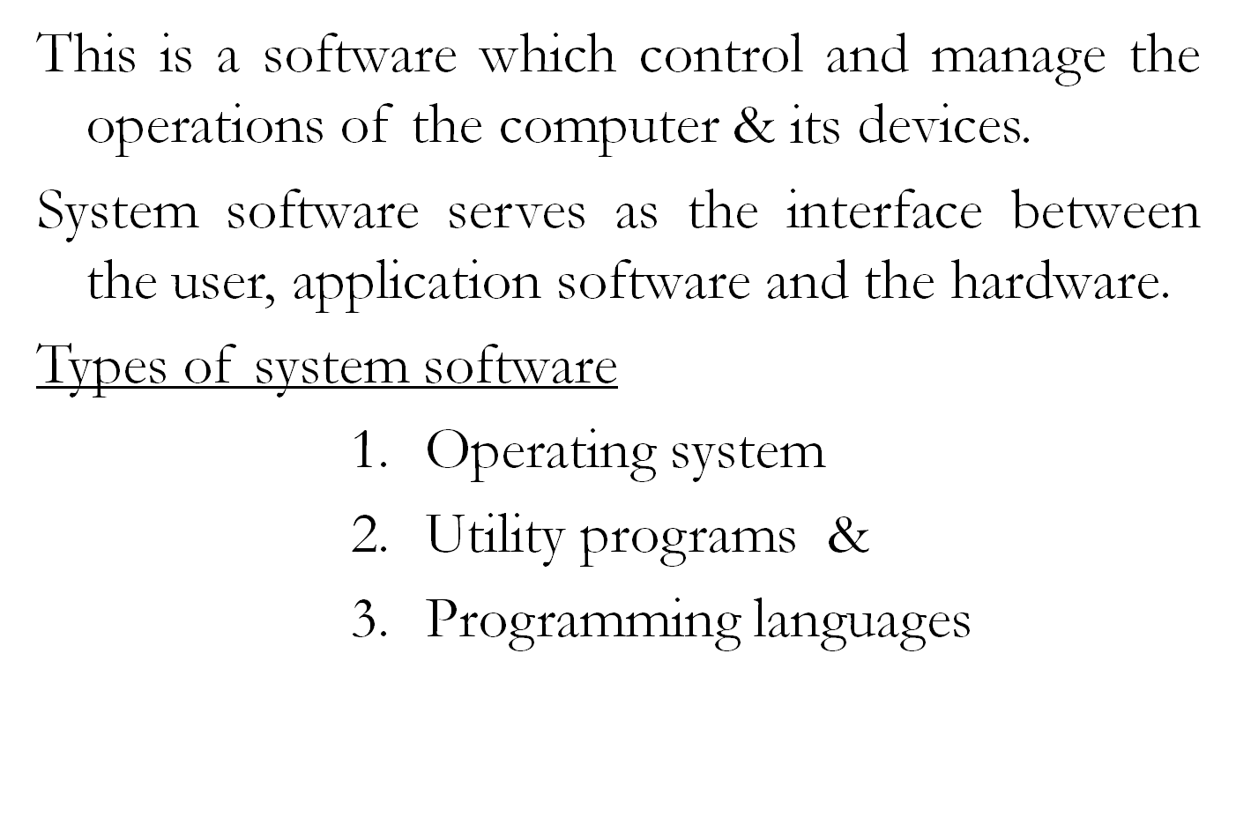
System software

Slide 12

This is a software that controls all the operations of the computer, all its input, output and storage elements
O/S manages the computer’s resources and acts as an interface between the user, the computer’s hardware and other software tools.
O/S relies on device drivers to manage computer devices.
A device driver is a small program that tells the operating system how to communicate with the computer devices.

Slide 13
Importance of device drivers
Device drivers facilitate detection of attached hardware devices.
Device drivers activate wireless network.
Device drivers provide an interface between hardware and software
Device drivers controls the use of the attached device on the computer.
Device drivers enable installation of multiple devices at the same time
It contributes to stability of device performance
Notes:
Why are device drivers too important during operating system software installation?

Slide 14
Examples of operating systems
Windows 7,
Windows XP,
Windows Vista,
Windows 2000,
Window 95,
Windows 98,
Mac OS,
UNIX
DOS. etc

Slide 15
Functions of the operating system
The OS provides an interface between the user and the computer.
It manages the computer processor by managing the flow of information in the computer.
It does File management; this includes keeping record of the saved files, their names, sizes, location etc.
The OS manages the shutting down of the computer.
It controls the loading and running of application programs.

Slide 16
General functions of the operating system…
6) It handles Errors whenever they occur.
7) It protects hardware and software from improper use.
8) It allocates system resources e.g. printers, memory etc to data and application programs
9) It completes the booting process of the computer.
11)It administers security on files using tools like pass words.
12 ) It controls input and output operations

Slide 17
Types of operating system
Operating systems are classified /categorized basing on:
The types / number of computers they control.
According to the number of users that can be logged in at a time.
The number of tasks an operating system can perform concurrently.
How users enter data and instructions into computer (user interface)
The processing mode

Slide 18
Classification of computer software…
Classification according to number of computers controlled.
    Stand alone operating system
    Networked operating system
1) Stand alone operating system
This is a type of operating system that runs only one machine when installed.
This type of operating system cannot support a network environment.

Slide 19
Classification of computer software…
Examples of stand alone operating system.
        Disk operating system (DOS)
        Windows 95,
        Windows 98,
        Windows Me,
        Windows 2000,
        Windows XP,
        Windows Vista,
        Windows 7,
        Windows 8 etc

Slide 20
Classification of computer software…
Networked operating system
This is a type of operating system that can manage all computers when installed on one as long as the other computers are linked to form a network e.g.
    Windows NT Server,
    Windows Net Server
    Windows 2008,
    Solaris,
    Novell NetWare,
    UNIX server,
    Linux server,
    O/s 2 wrap series

Slide 21
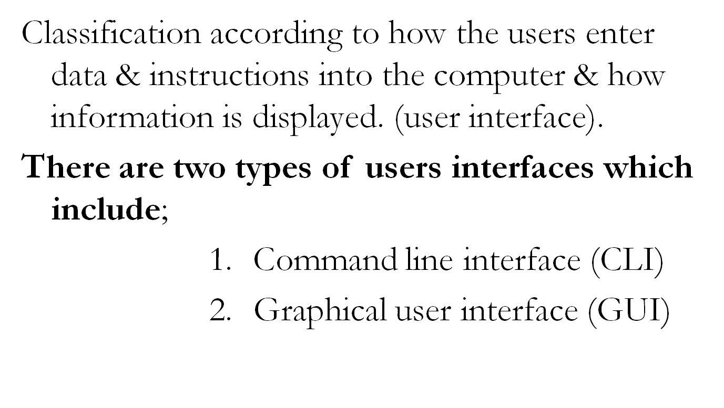
Classification of computer software…

Slide 22
Classification of computer software…
Command line interface (CLI)
This is user interface where a key board is used to issue commands to the computer.
The instructions are normally issued or typed at a command prompt. (C:\>-.)
This type of operating system is referred to as command driven

Slide 23
Advantages of CLI
It takes up little memory resources to run because it is light.
The operations are very fast because commands can be entered directly through the key board.
It is precise because the user states exactly what he or she wants to do.
Users have much more control of their file system and operating system in a command line interface. For example, users can easily copy a specific file from one location to another with a one-line command.

Slide 24
Disadvantages of CLI
Difficult to use by new users because a command language has to be learnt and memorized.
CLIs cannot show images.

Slide 25
Graphical user interface (GUI).
This is a type of operating system that uses icon to issue (enter) commands into the computer.
An icon is a graphical representation of a program or a file.
With this type of operating system, the user simply clicks on the icon to give instructions to the computer.

Slide 26
Features of the graphical user interface
A GUI has the following features;
Windows to enable user to multi task
Icons to help the user identify applications / folders
Menus to help the user choose options
Pointing device to click and open files/software
Nb. The acronym WIMP is used to refer to Windows, Icons, Menus and Pointing device in respect to GUI.
Notes:
Outline the basic components of the GUI

Slide 27
Advantages of GUI
    It is user friendly because it is easy to learn and work with.
    There is no need to type and memorize any command language.
    It provides a similar interface for any application.
    GUIs have windows that enable a user easily to view, control and multitask.
    GUI enables a user to create shortcuts on the desktop which can run a program easily.
    GUIs generally provide users with immediate, visual feedback about the effect of each action.
Notes:
For example, when a user deletes an icon representing a file, the icon immediately disappears, confirming that the file has been deleted.

Slide 28
Disadvantages of GUI
It requires more memory as well as a faster processor.
It occupies more disk space to hold all files for different functions.
The user choices are restricted to those on the menus
It might be slower to download into memory.
It might require the installation of additional software, e.g., the "runtime environment" in the case of java.

Slide 29
Differences between dos and windows
Dos | Windows
Takes up little memory | Requires more memory as well as a faster processor
Operation is fast because commands can be entered directly. | Depends on the strength of the computer
Commands have to be learned | User-friendly and easy to learn
Commands have to be memorized | No need to memorize commands.

Slide 30
Reasons for installing or reinstalling an operating system
To upgrade to a more advanced operating system.
When the existing operating system files have been corrupted and it therefore no longer functions.
To set up a brand new machine which was supplied without an operating system.
To perform a recovery on the computer after it has suffered a fatal error, when it is best to start with a clean, freshly formatted hard drive.
Notes:
Give Reasons why you might need to install or reinstall an operating system:

Slide 31
Factors to consider when choosing an operating system
The Human–computer interface
The Applications intended for the computer.
The Cost of the operating system.
Its availability on the market.
Reliability of the operating system.
The basic design of the computer.
The Hardware provisions of the computer.

Slide 32
2. UTILITY PROGRAMS
These are general purpose programs that enhance/ boost the performance of a computer.
They are designed to configure, analyse, optimise, and maintain a computer in a normal working state.
Some utility programs are included with the operating system (for example, disk repairing programs) while others are purchased separately by the user (for example, Norton Disk Doctor).

Slide 33
Examples of utility programs
Sorting utility
Merging utility
Back up utility
Antivirus utility
Data compression utility
Screen savers
Scandisk utility
File viewer
Un installer
Disk defragmenter
Disk repair utility
Computer language translators
Disk partitioning software
Disk compression utilities
File managers
Diagnostic utility.

Slide 34
Functions of utility programs
File /data compression utility. This is used to squeeze large files so that they can require less storage space.
File Viewer: Displays the content of a file.
Sorting utility: Takes in data and arranges it as specified by the user.
Antivirus utility: Prevents, detects and removes viruses.
Merging utility: This combines data from two or more files to form one general file
Notes:
Compressed files sometimes are called Zipped Files because they usually have a zip extension.
examples of antivirus utility include:

Slide 35
Functions of utility programs
Folder management utility: This is used for creating, viewing, deleting and rearranging files and folders
Compression utility: Reduces the size of files to free disk space
Antivirus utility: This Prevents, detects and removes viruses.
Uninstaller utility: This removes programs from the computer.
Cryptographic utilities: Used to encrypt and decrypt files.

Slide 36
Functions of utility programs
Backup utility: Used to makes a duplicate copy of every file on the hard disk which can be store on the CD or flop
Disk Defragmenter: finds fragmented files on the hard disk and organises them in a contagious manner.
Diagnostic utility Compiles technical computer information & outline any identified problems
System profilers. Provide detailed information about the software installed and hardware attached to the computer.

Slide 37
Functions of utility programs
System profilers. Provide detailed information about the software installed and hardware attached to the computer.
Network utilities: Analyses the computer’s network connectivity, configure network settings, check data transfer and log events.
Scandisk: Scans the computer disk to see if there is any potential problem such as bad disk areas, and possibly repair them.

Slide 38
18) Screen saver utility.
This is a utility program which causes the computer monitor to automatically displays a moving image (graphic) after a period when the computer is on but not in use.
The original reason for introduction of Screen saver utility was to prevent phosphor burn-in (ghosting effect) of CRT and plasma computer monitors

Slide 39


Slide 40

Practical application of screen savers
screen savers have Practical uses to a computer user which include;
      Entertainment
      Security
      Advertisement
      Source of information

Slide 41
3. PROGRAMMING LANGUAGES
These are sets of instructions used by programmers (users) to build, design or write other computer programs.
Programming languages are commonly referred to as system development software.
A programming language has a unique set of keywords and a special syntax for expressing and organizing program instructions.
Syntax refers to the spelling and grammar of a programming language.

Slide 42
Categories of programming languages
There are two categories of programming languages
      Low level programming languages
      High level programming languages
Notes:
Mention the two categories of programming languages

Slide 43
a) Low level programming languages
This is the lowest possible level of language in which it is possible to write a computer program.
It is a programming language which is more close to the computer native language i.e. 0s and 1s
Categories of low level programming language
    Machine language
    Assembly language

Slide 44
Low level programming languages…
Machine language
This is the first generation language consisting of binary digits ( strings of 0s and 1s)
In a machine language, Each character is represented by binary digits (BITS) E.g. A= 01000001- ASCII
The main problems with using machine code directly are that;
It is very easy to make a mistake, and very hard to find it once you realize the mistake has been made.
It is very difficult to be under by human being

Slide 45
High level programming languages.
These are programming languages that closer to human languages and further from machine languages.

Slide 46
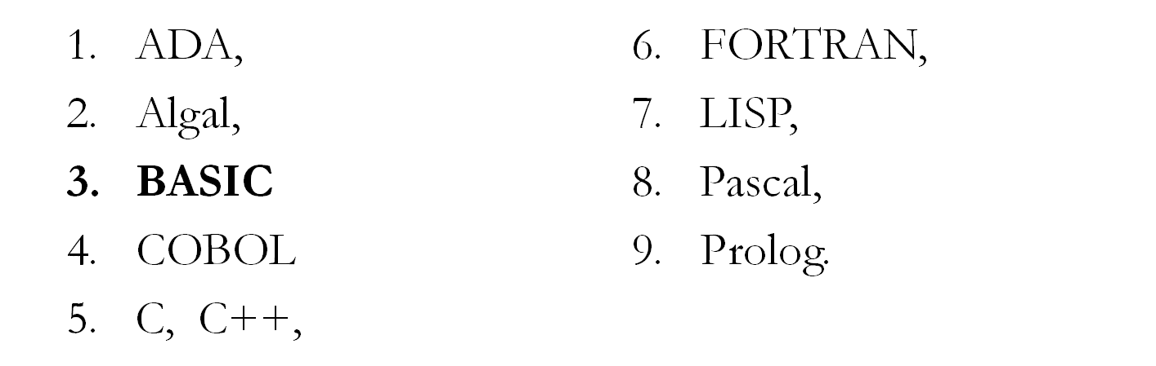
Examples of high level programming languages
BISIC: Beginners All purpose Symbolic Instruction Code
Cobol: Common Business Oriented Language.
FORTRAN: FORmula TRANslation
Algal: Algorithmic language

Slide 47
Advantages of using high level programming languages.
High level language is easy to understand by programmers because it is closer to human language.
High-level programming languages are problem oriented, therefore they enable the programmer concentrate on solving the problem.
The words and grammar of high-level languages are English-like and this makes the programs more readable and easy to write.

Slide 48
Advantages of using high level programming languages.
A high-level languages are machine independent Since the syntaxes of high-level languages are standardized so that they can be used on different computer systems.
they are easier to read, write, and maintain.
They also permit faster development of large programs.

Slide 49
Qualities of a good programming language
  Suitability of the problem.
  Clarity and simplicity.
  Efficiency
  Availability
  Consistency
The above are the criteria to be used when choosing a programming language and then the platform whether windows or DOS based.

Slide 50
Language processors
A language processor is a program that translates a program designed in high level programming language into a machine code.
These include;
      Compilers
      Interpreters
      Assemblers
      Debuggers

Slide 51
Language processors…
Compilers: This is a program that coverts a source code written in a high level language into a computer language as a whole.
Interpreters: is a program that coverts a source code written in a high level language into a machine language line by line.
Assemblers: these translate assembly instruction or language in machine code.
Debuggers: these are programs which remove errors from a program.

Slide 52
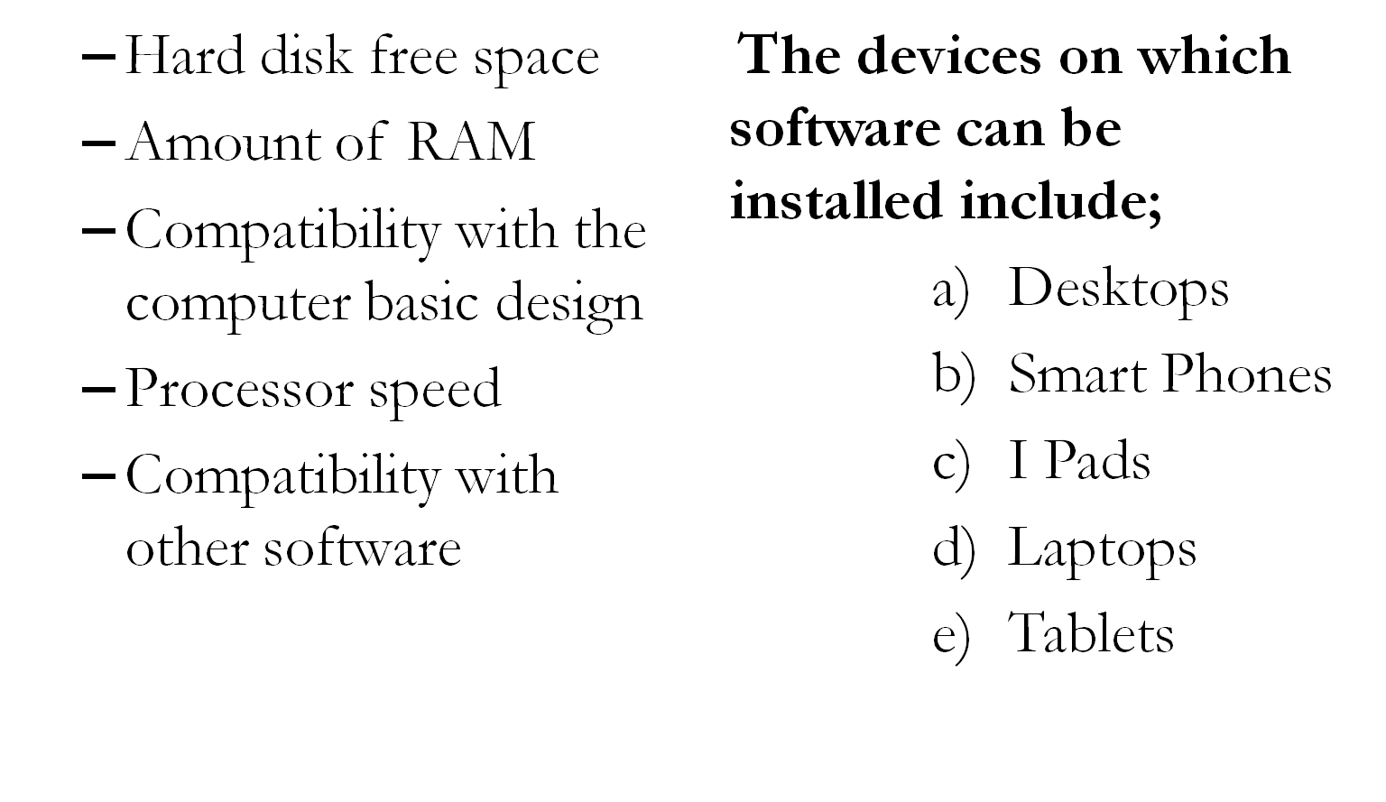
Factors considered before installing software on a computer.
Notes:
Mention any two factors you would consider before obtaining software

Slide 53
APPLICATION SOFTWARE
These are programs that are designed to solve specific end user needs.
A computer application refers to the use of the computer to solve specific problem for the user.

Slide 54
Types of application software
Basing on the mode of acquisition, application software is categorized into;
      Freeware
      Open source
      Shareware
      Public Domain software
      Off the shelf software
      Custom made software.

Slide 55
Types of application software…
Freeware: This is copyrighted software provided at no cost to users.
Open source (OSS).This is copyrighted software for which the software plus the source code are freely distributed.
Public Domain software. This is free software donated for public use and has no copyrighted restrictions.
Shareware. This is a copyrighted software that is distributed free for a trial period and payment is required for using the software beyond trial period.

Slide 56
Types of application software…
    5. Off the shelf software
    OTS are commercial software packages that are already-made by the company to meet the needs of a wide variety of users and are sold together as a single package.
    This software is also called packaged software or software suite or General purpose software.
Examples
MS office suite
Computer games packages
Education software packages

Slide 57
Advantages of off-the-shelf software
Off-the-shelf software is Cheaper because it is massively produced and packaged for commercial purposes.
Off-the-shelf software perform a wide range of tasks.
It has a lot of such as online help, books, and discussion forums to guide the users in case of any problems.
Off-shelf is easy to learn and use (user friendly)
It is easy to install.
It is More reliable because it is tried and well tested by many users.
It is Easily available from most computer vendors

Slide 58
Disadvantages of off-the-shelf software:
i) Off-the-shelf software is highly complex because It includes large sections that a user may never use.
Off-the-shelf software does not address needs of specific users.
It takes a longer period of time to properly learn how to use off the shelf software.
off-shelf may not address some of the individual needs of the user. There will probably be operations that you require that you simply cannot do with the software.

Slide 59
Disadvantages of off-the-shelf software…
v) It is very difficult to gain any competitive advantage from its use over business rivals because they use the same software.

Slide 60
6. Custom made software.
This is an application software which is developed at a user’s request to perform specific functions.
The individual user hires programmers to design such a program.
Examples of custom made software
  school management information systems(SMIS)
  Inventory management systems
  Payroll management systems
  Library management systems
  Report making software

Slide 61
Advantages of Custom-made software
The software also performs tasks that the general purpose software cannot perform.
A custom-made application directly addresses the user’s needs because it is written to the user’s requirements and fits in with his/her work.
The software developer delivers and installs the software and trains the end users in the use of the new software.
This kind of software can be quickly changed when the needs of the organization change, since the source code belongs to the company.

Slide 62
Disadvantages of custom made
It is expensive because it requires hiring a programmer to develop the software, to install and to provide on-site support and training.
Usually lacking online help services.
It takes time to acquire because of the need to get information necessary and to write the code of the new software.
It lacks online support to guide the user in case of a problem.
It requires extensive training before use
It May contain un detected programming errors/bugs since it is not tested adequately.
Notes:
Distinguish between vertical and horizontal application software
Vertical application software is application software designed basing on the user specifications and requirements while horizontal application is a program designed to serve a variety of users.

Slide 63
Examples application software
1) Word Processor
Used for producing text-based documents like letters, notes, reports, memos, etc.
2) Spreadsheet software
Used for performing calculations e.g. budgeting statistics, financial data, creating of graphs.
3) Database management software (DBMS)-
Used in the creation and management of large amount of information related to a particular topic or subject. E.g. students details, employee pay rolls, product details, customer and supplier’s information etc.
Notes:
Explain any ten end-user application programs available in the market today.

Slide 64
Examples application software
4) Presentation software:
Used for creating slide based shows which enhance a speech presentation.
5) Accounting software
Used for preparing payrolls, capturing cash inflows and outflows, generating financial statements as well as balance sheets, etc.
6) Computer aided design (CAD) software –
Used by engineers and architects to produce plans for houses, bridges, car parts, roads, etc.
Notes:
Explain any ten end-user application programs available in the market today.

Slide 65
Examples application software
7) Desktop publishing software –
This application specializes in creating cards, flyers, calendars, brochures, etc which can be useful for projects.
8) Web authoring software Used by webmasters for building websites.
9) Audio and video editing software
Used by movie editors to create and edit movies with various transitions and animations.

Slide 66
Examples application software
10) Communications software
Used for taking cyber classes, sending and receiving emails, e.g. Internet Explorer.
11) Graphics software
Used by graphic designers to design book covers, cartoons etc.
12) File Recovery software
A unique application used for recovering accidently or just deleted files from the computer.
e.g. Recover My Files.

Slide 67
A software suite
Application software is normally sold in a set called a suite.
A software suite is a collection of individual application soft-ware programs sold as a single package.

Slide 68
Examples popular office software suites
      Lotus Smart Suite
      Microsoft Office
      Apple iWork
      Koffice
      OpenOffice.org
      LibreOffice
      WordPerfect Office
      Celframe Office
      Ability Office e.t.c.
Notes:
Mention the names of any three popular office software suites

Slide 69
Advantages of buying / using software suites
It is cheaper in cost than buying each of the application packages separately.
It is easy to learn and use because applications within a suite usually use a similar interface and share common features such as clip art and toolbars.
Easy to install because all the various applications can be installed at once.
More reliable because it is tried and well tested by many users.
Notes:
Give any three advantages of buying / using software suites as compared to buying single software applications.

